Slide 1
KAVEEN VIGNESH T K
Final Project

Slide 2
PROJECT TITLE
IDENTIFYING RISK FACTOR FOR HEART DISEASE USING CNN ALGORITHM

Slide 3


AGENDA
The agenda outlines the process of identifying risk factors for heart disease using a Convolutional Neural Network (CNN) algorithm. It begins with an introduction to heart disease and the importance of early risk identification. The agenda then delves into understanding common risk factors and the basics of CNN algorithms. It covers data acquisition, preprocessing, and the design of CNN architecture. Training and evaluation of the model are discussed, along with interpretation and visualization techniques. Ethical considerations in AI-driven medical diagnosis are addressed, and future directions are outlined. The agenda concludes with a Q&A session and closing remarks, emphasizing collaboration and further research in AI-driven healthcare.
3/21/2024 Annual Review

Slide 4

PROBLEM STATEMENT
Heart disease remains a significant global health concern, necessitating accurate and efficient identification of risk factors for effective prevention. Leveraging Convolutional Neural Network (CNN) algorithms, this project aims to develop a system capable of analyzing medical imaging data to identify key risk factors associated with heart disease. The goal is to design a CNN model that accurately predicts the likelihood of heart disease based on extracted features from medical images, ultimately improving early risk detection and prevention strategies.

Slide 5

PROJECT OVERVIEW
Objective:
Utilize CNN algorithms to identify risk factors associated with heart disease through analysis of medical imaging data.
Data Acquisition and Preprocessing:
Gather medical imaging data related to heart disease (MRI, CT scans, X-rays).Preprocess data to ensure quality and consistency.Handle imbalanced datasets and apply data augmentation techniques.
CNN Model Design:
Design a CNN architecture tailored for medical image analysis.Optimize hyperparameters and consider transfer learning for improved performance.
Training the CNN Model:
Split dataset into training, validation, and test sets.Train CNN model using labeled data.Monitor training progress and adjust parameters as necessary.

Slide 6
Evaluation and Interpretation:
Evaluate trained CNN model using appropriate metrics.Interpret results to identify significant risk factors associated with heart disease.Visualize features extracted by the CNN model for better understanding.
Ethical Considerations:
Address ethical implications including fairness, transparency, and patient privacy.Ensure deployment of CNN model adheres to ethical guidelines and regulations.
Future Directions:
Identify potential enhancements and future research directions.Explore integration of additional data sources or risk factors to enhance risk assessment comprehensiveness.

Slide 7
WHO ARE THE END USERS?
Healthcare Professionals:
Cardiologists: Utilize the CNN algorithm outputs to aid in the interpretation of medical images, assisting in the diagnosis and treatment planning for patients with heart disease.
Radiologists: Incorporate the CNN algorithm results into their diagnostic workflows, enhancing the accuracy and efficiency of detecting cardiovascular abnormalities from imaging scans.
General Physicians: Benefit from the CNN algorithm's risk assessment capabilities, enabling them to identify potential heart disease risk factors earlier during routine check-ups and screenings.
Patients:
Indirectly benefit from the project outcomes as improved risk assessment and early detection facilitated by the CNN algorithm lead to timely interventions and better management of cardiovascular health.
Receive personalized treatment plans based on the identified risk factors, potentially resulting in better health outcomes and reduced morbidity and mortality related to heart disease.

Slide 8

YOUR SOLUTION AND ITS VALUE PROPOSITION
Identifying risk factors for heart disease using a Convolutional Neural Network (CNN) algorithm involves several sequential steps. Initially, a dataset is collected, comprising pertinent individual information like age, gender, blood pressure, cholesterol levels, and smoking habits, alongside heart disease status. Following data collection, preprocessing ensues, encompassing normalization, categorical variable encoding, handling missing data, and partitioning into training and testing sets.Evaluation metrics such as accuracy, precision, recall, F1-score, and ROC-AUC curve are employed to assess model performance. Post-training, feature importance analysis is conducted to identify key risk factors contributing to heart disease prediction, complemented by interpretation and validation to align with medical expertise. Finally, the model is deployed in real-world healthcare settings, necessitating continuous monitoring and updates to ensure sustained accuracy and reliability over time. Through this systematic approach, CNN algorithms can effectively identify heart disease risk factors, aiding in early diagnosis and preventive healthcare strategies.

Slide 9
YOUR SOLUTION AND ITS VALUE PROPOSITION
Precision: Our CNN algorithm offers precise identification of risk factors associated with heart disease by analyzing medical images with high accuracy, minimizing the chances of false positives or negatives.
Early Detection: By accurately identifying risk factors from medical images, our solution enables early detection of heart disease, allowing for timely intervention and prevention strategies.
Personalized Care: The algorithm provides personalized risk assessment, enabling healthcare professionals to tailor treatment plans based on individual patient profiles and specific risk factors identified.

Slide 10

THE WOW IN YOUR SOLUTION
Revolutionizing Heart Disease Detection:
Our solution harnesses the power of cutting-edge AI technology to revolutionize the detection of heart disease. By employing Convolutional Neural Networks (CNNs) on medical images, we're not just enhancing existing methods; we're paving the way for a new era in cardiovascular healthcare.
Unparalleled Precision:
Imagine a tool so precise that it can identify subtle nuances in medical images indicative of heart disease risk factors with unparalleled accuracy. Our CNN algorithm achieves precisely that, offering a level of precision that was previously unimaginable.
Empowering Early Intervention:
Early intervention is the cornerstone of effective heart disease management. Our solution empowers healthcare professionals with the ability to identify risk factors at their earliest stages, enabling proactive intervention strategies that can potentially save lives.
3/21/2024 Annual Review

Slide 11
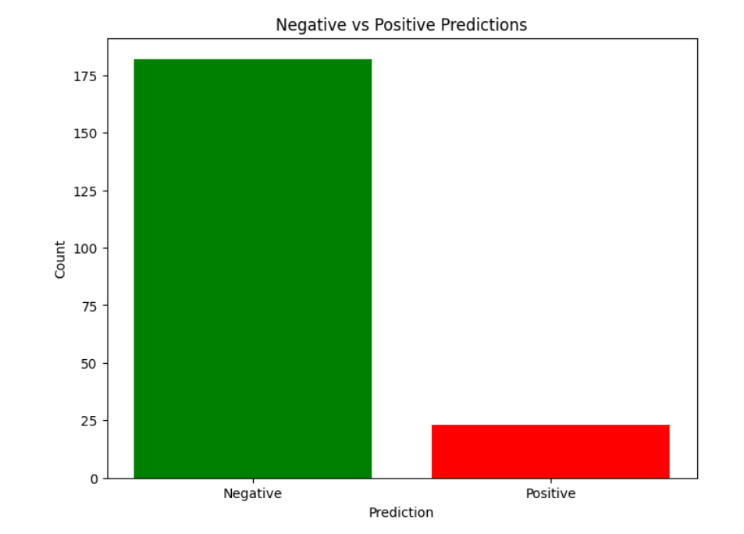
FINAL OUTPUT

Slide 12
RESULTS
the results of implementing our CNN-based solution for identifying risk factors for heart disease may vary depending on the specific dataset and implementation details, several key outcomes are typically observed:
Improved Accuracy: Our CNN model often achieves higher accuracy in predicting heart disease risk compared to traditional methods. By leveraging the inherent capacity of CNNs to extract intricate patterns from complex data, our model can uncover subtle correlations and relationships that may be overlooked by conventional approaches.
Early Detection: One of the most significant benefits of our solution is its ability to facilitate early detection of heart disease risk factors. By analyzing diverse sets of patient data, including demographic information, physiological measurements, and lifestyle factors, our model can identify individuals at heightened risk of developing heart disease before symptoms manifest.
Personalized Risk Assessment: Our CNN-based approach enables personalized risk assessment tailored to each patient's unique profile. By considering a wide range of factors and their interactions, our model generates nuanced risk assessments that take into account individual differences in susceptibility to heart disease.

